Slide 1
Allstate/Stanford Research Update: Observation Noise
Shubh Gupta
Dec 14, 2020

Slide 2
Stress Testing with Observation Noise using the Approximate Method
Key features:
RL-based search on the space of noisy agent states
Reward
Computed from specified observation probabilities and state estimation algorithms
Interpreted as probability of a sequence of noisy states being computed by the algorithm
Observation Probability Distributions
Reward
log probability
Sequence of Noisy States
State Estimation Algorithm
AST
actions

Slide 3
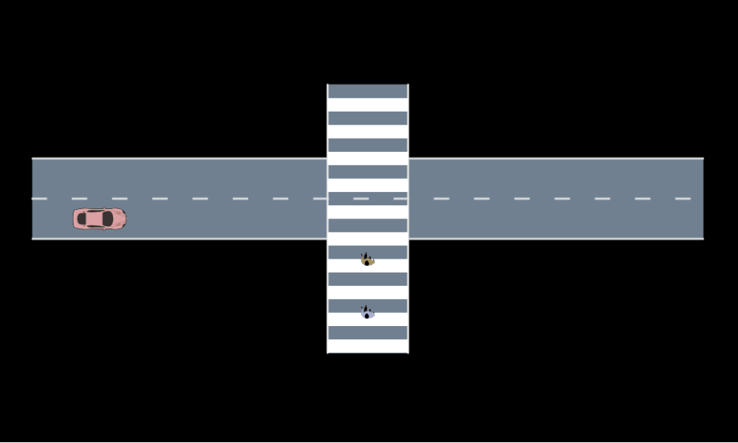
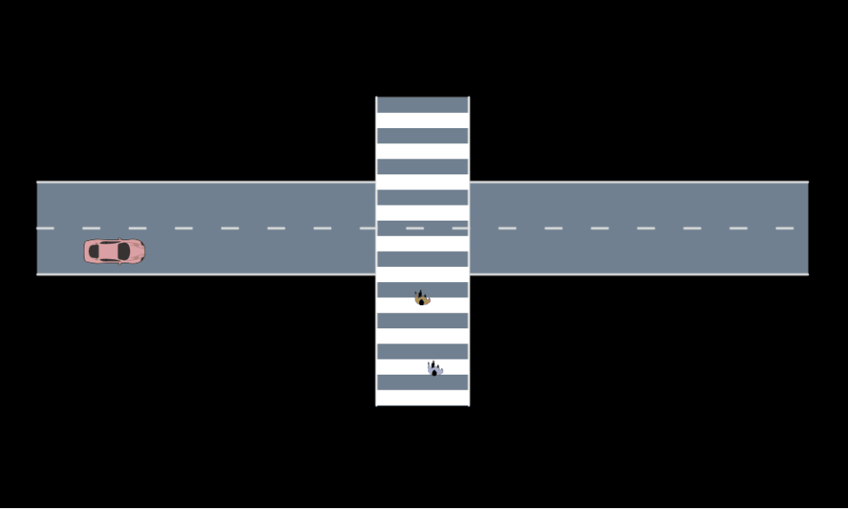
Example #1: Pedestrian Noise
Pre-computed distribution from GPS measurements
Probability estimated at search time from samples
Actual Position
Noisy Position

Slide 4
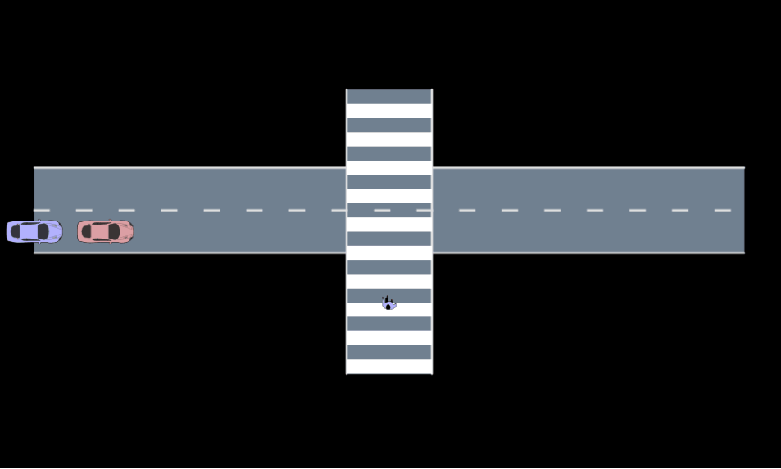
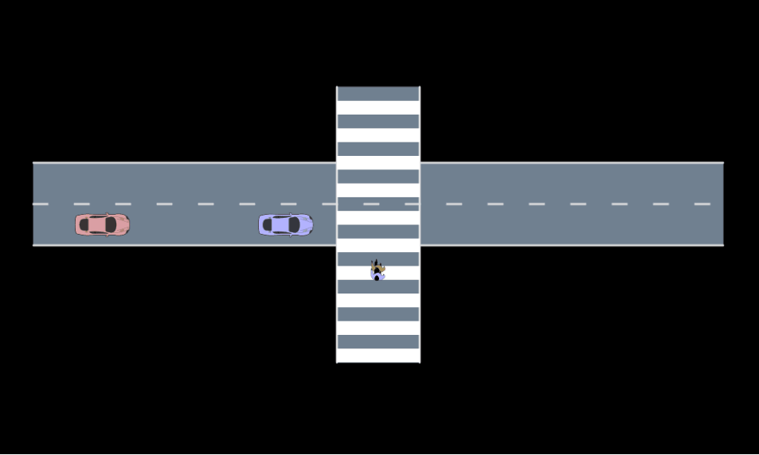
Example #2.1: Vehicle Noise
Manually identified failure case
Pre-computed distribution from unbiased GPS measurements
Actual Position
Noisy Position

Slide 5
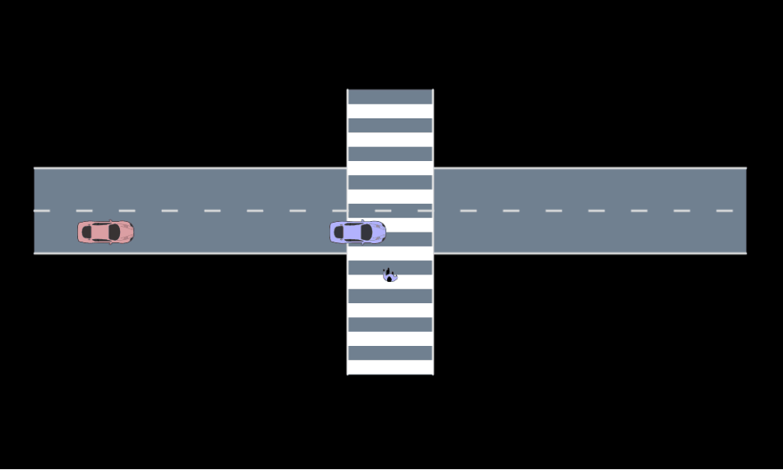
Example #2.2: Vehicle Noise
Manually identified failure case
Pre-computed distribution from biased GPS measurements
Actual Position
Noisy Position

Slide 6
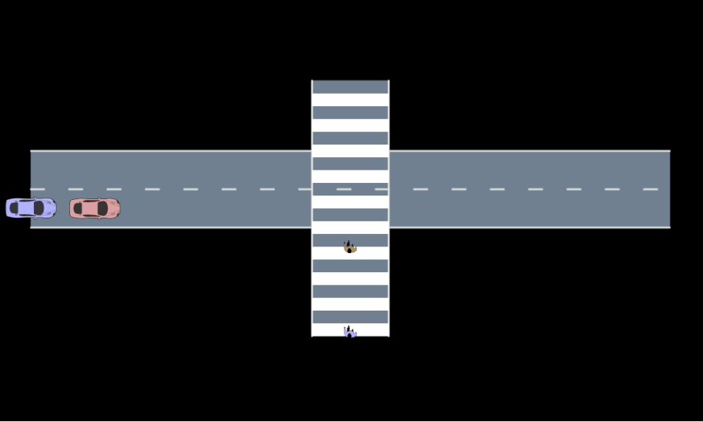
Example #3: Both Vehicle and Pedestrian Noise
Pre-computed distribution from biased GPS measurements
Actual Position
Noisy Position

